Slide 1
Liver Cirrhosis and Liver Cell Failure
By /zeinab Ramadan Mohamed
Assistant lecture of Tropical Medicine and gastroenterology

Slide 2
.
Cirrhosis is the widespread distortion of the liver's internal structure that occurs when a large amount of normal liver tissue is permanently replaced with nonfunctioning scar tissue. Which of the following is a common cause of cirrhosis of the liver in developed countries?

Slide 3
.
A. Alcohol abuse
B. Celiac disease
C. Gallbladder surgery
D. Kidney disease

Slide 4
A prominent sign or symptom of liver disease is:
A. A high cholesterol level
B. Unexpected hair loss
C. Yellowish skin discoloration
D. High blood pressure

Slide 5
.
In liver disease, the appearance of the abdomen might be swelled up. This swelling results from:
A. An accumulation of fluid
B. An increase in body fat
C. An accumulation of toxins in the liver
D. Ongoing constipation

Slide 6
.
When a doctor diagnoses reduction or stoppage of bile flow from the liver, the condition is called:
A. Hepatomegaly
B. Cholestasis
C. Cholecystectomy
D. Encephalopathy

Slide 7
.
Wilson disease is a rare hereditary disorder. In patients who have Wilson disease, the liver does not excrete excess copper into the bile as it normally does; the result is an accumulation of copper in the liver and liver damage. Which of the following liver diseases results from this process?
A. Cholestasis
B. Cirrhosis of the liver
C. Fatty liver
D. Portal hypertension

Slide 8
.
Liver tests are blood tests that screen for the presence of liver disease. Which of the following is NOT a function of liver tests?
A. Assessing the severity of liver disease
B. Detecting liver inflammation, damage, or dysfunction
C. Diagnosing alcohol use disorder
D. Monitoring a person’s response to treatment

Slide 9
.
Measurement of which of the following determines the time needed for blood to clot and, if abnormal, can indicate an acute or chronic liver disorder?
A. Albumin level
B. Alpha-fetoprotein level
C. Gamma-glutamyl transpeptidase level
D. Prothrombin time

Slide 10
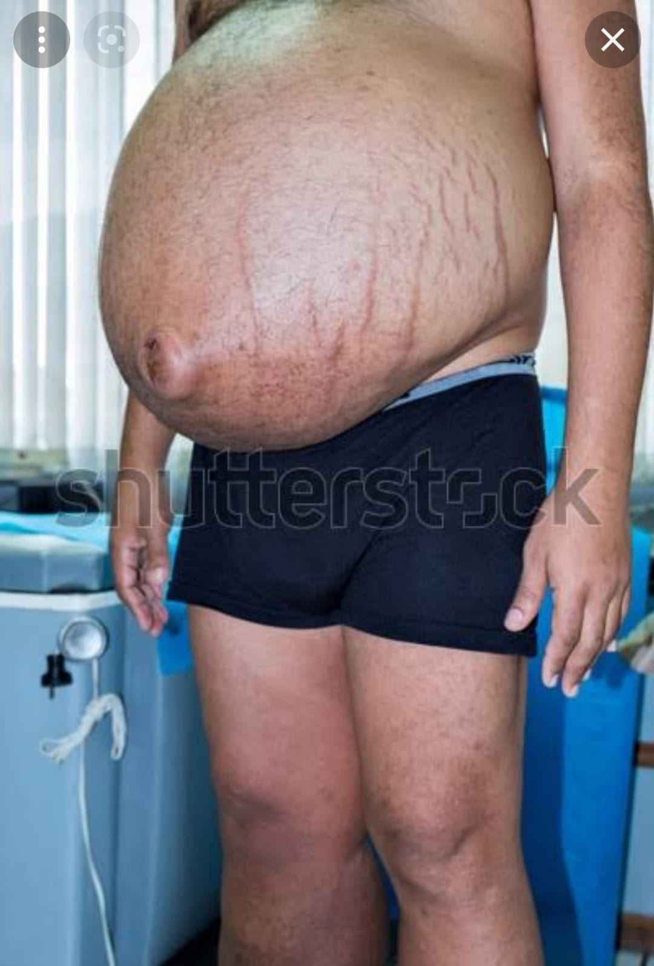

Slide 11
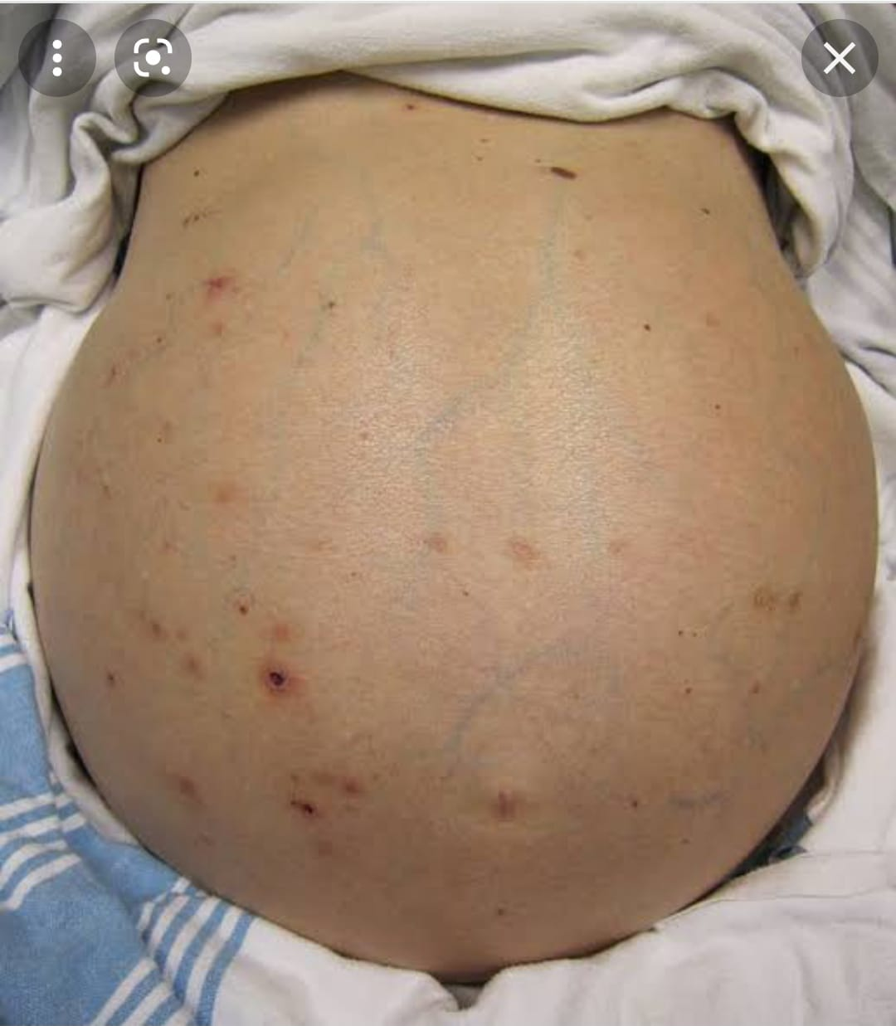

Slide 12
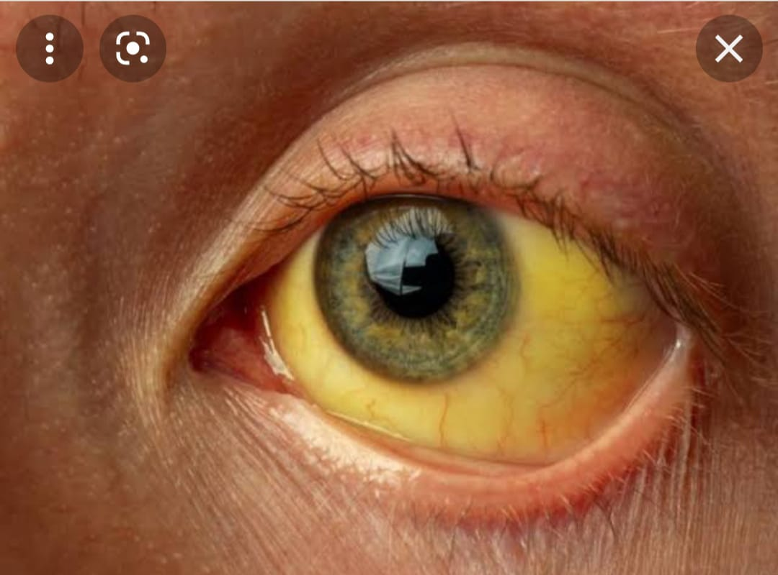

Slide 13
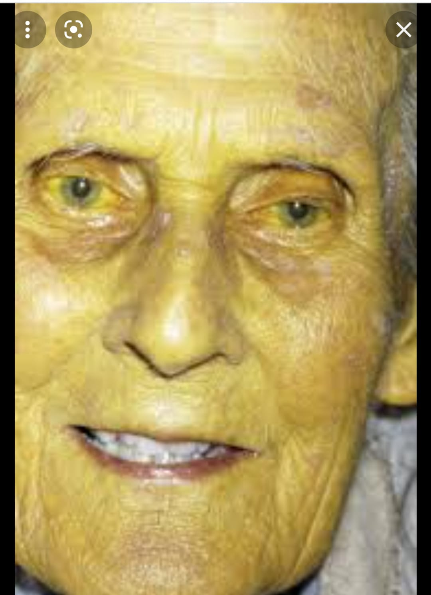

Slide 14
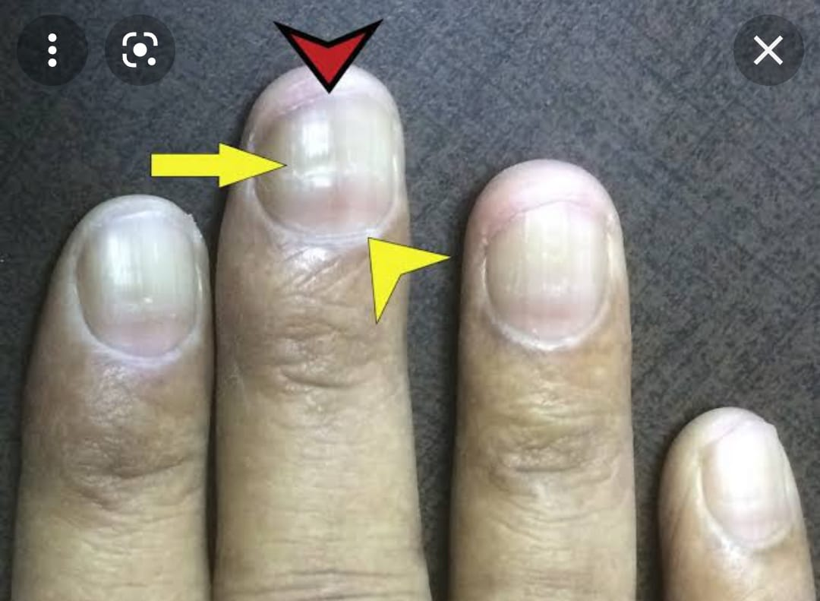

Slide 15
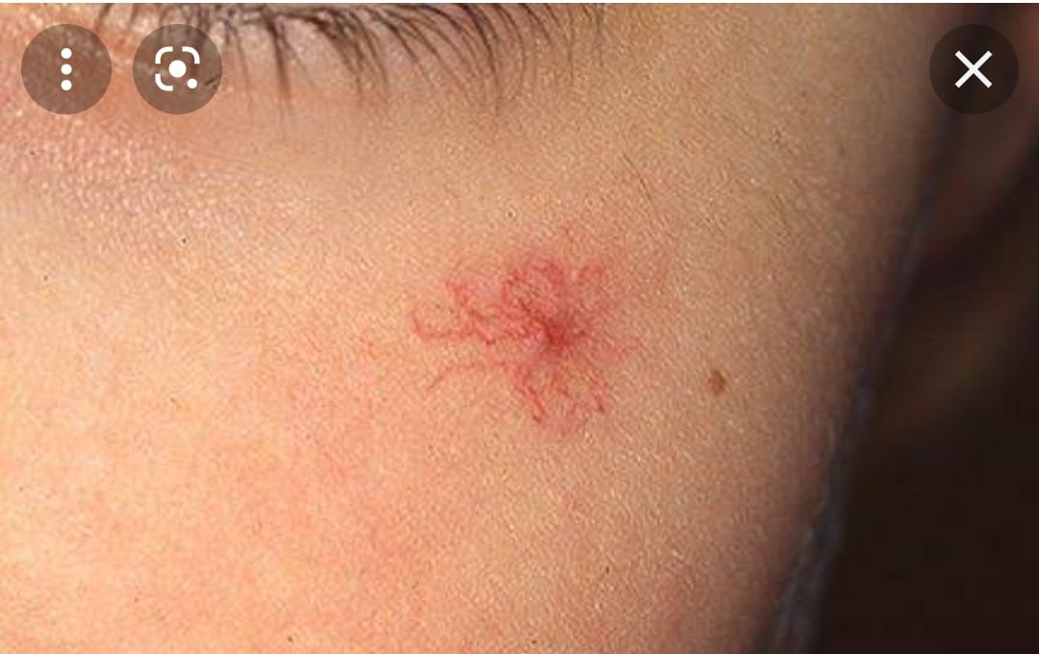

Slide 16
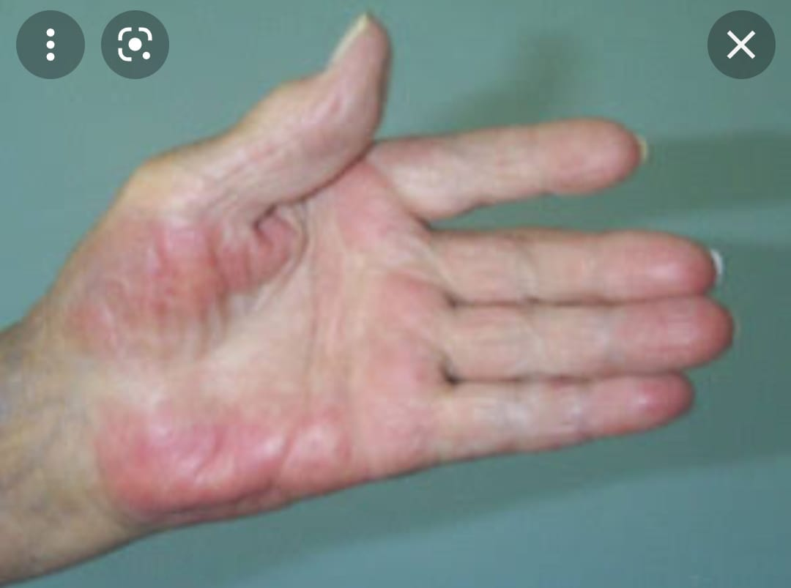

Slide 17
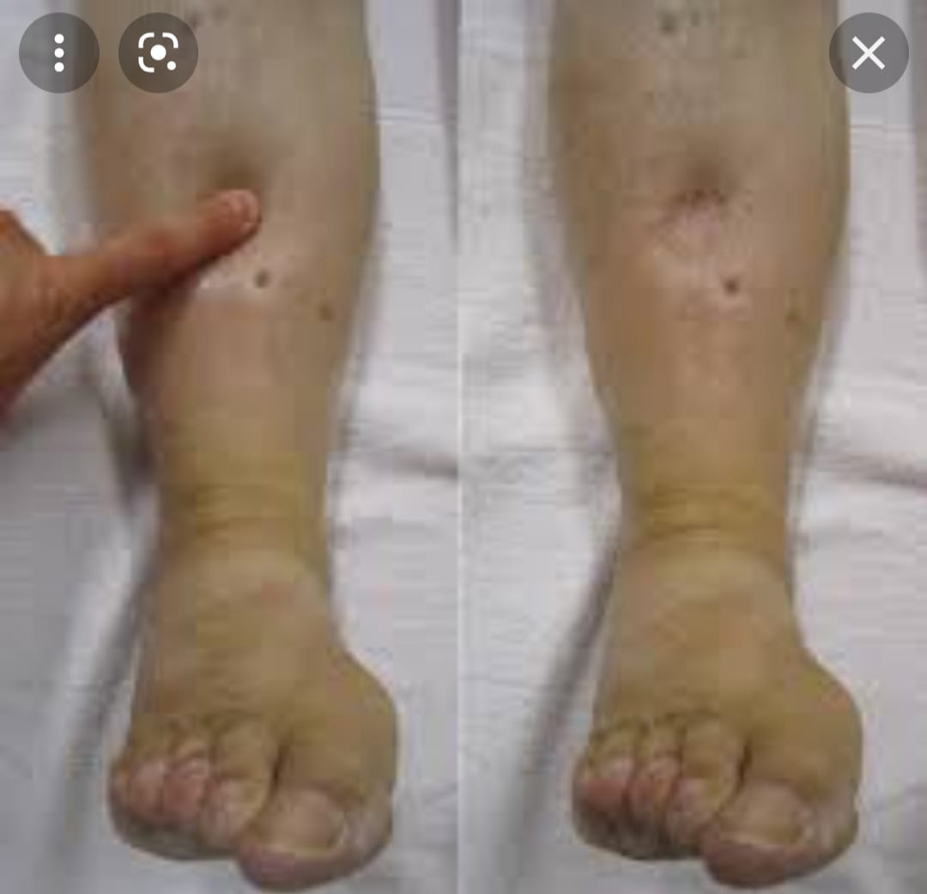

Slide 18
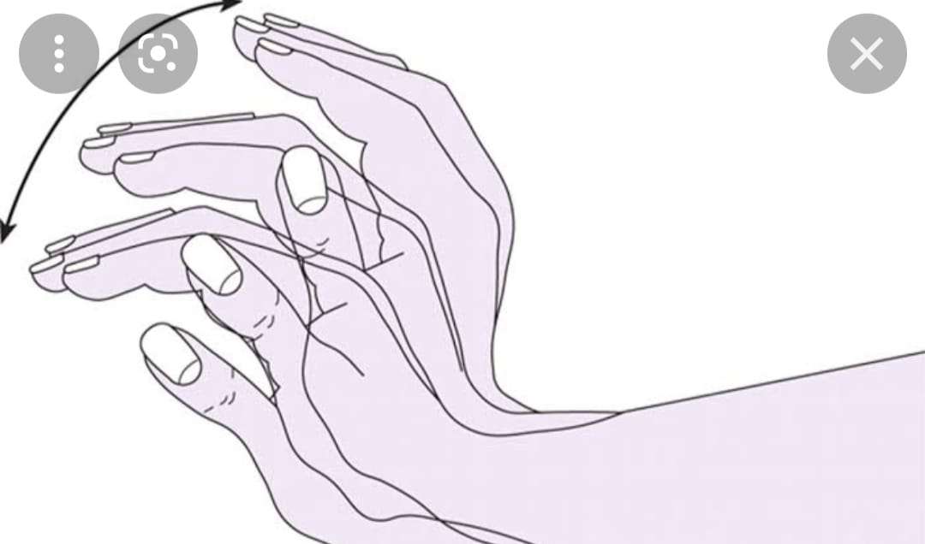

Slide 19
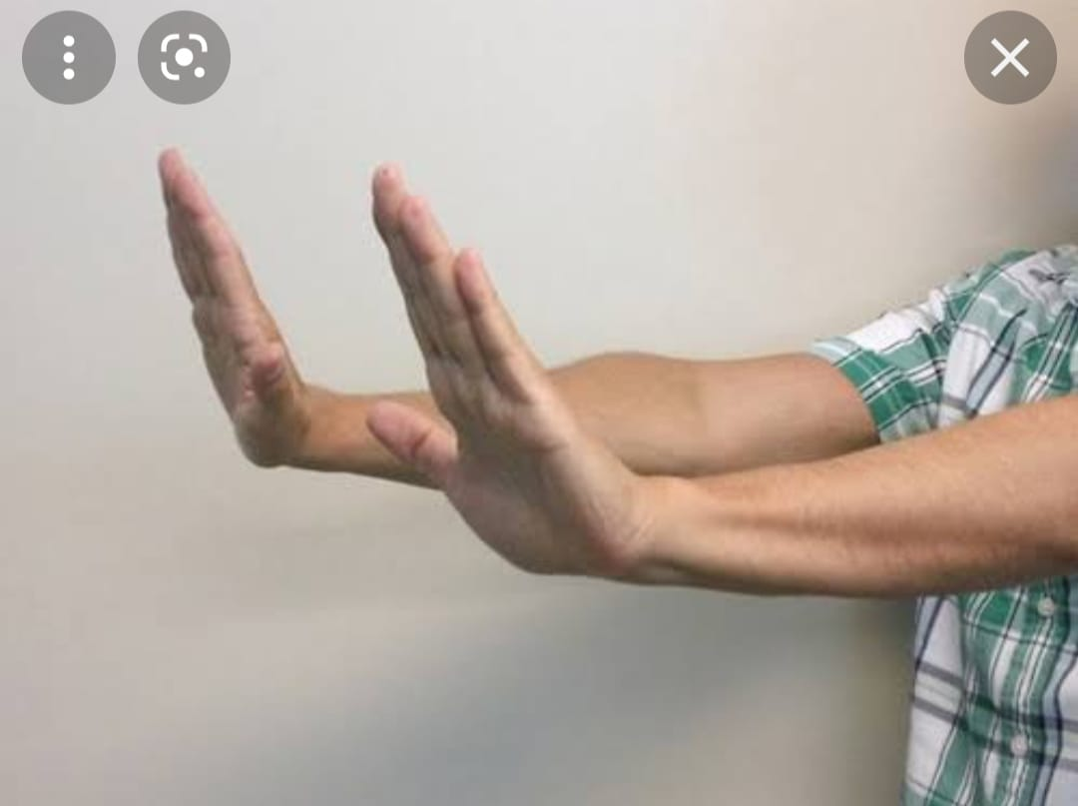

Slide 20
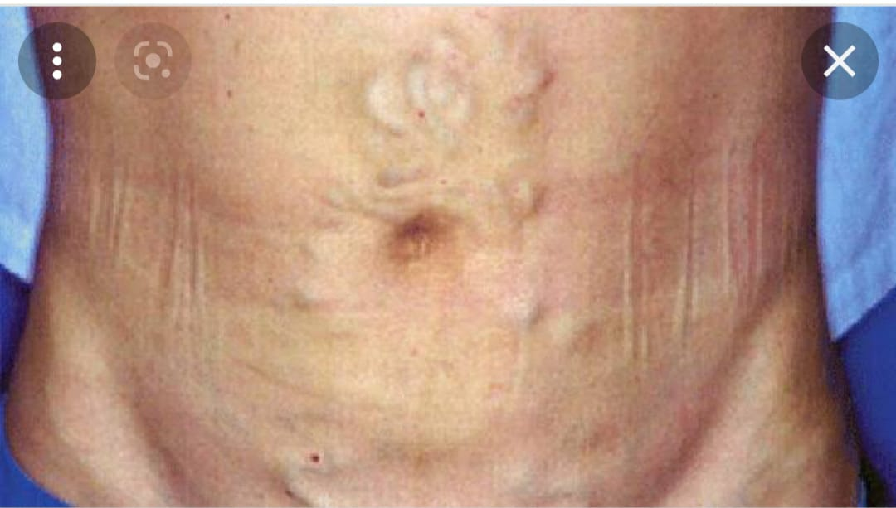

Slide 21
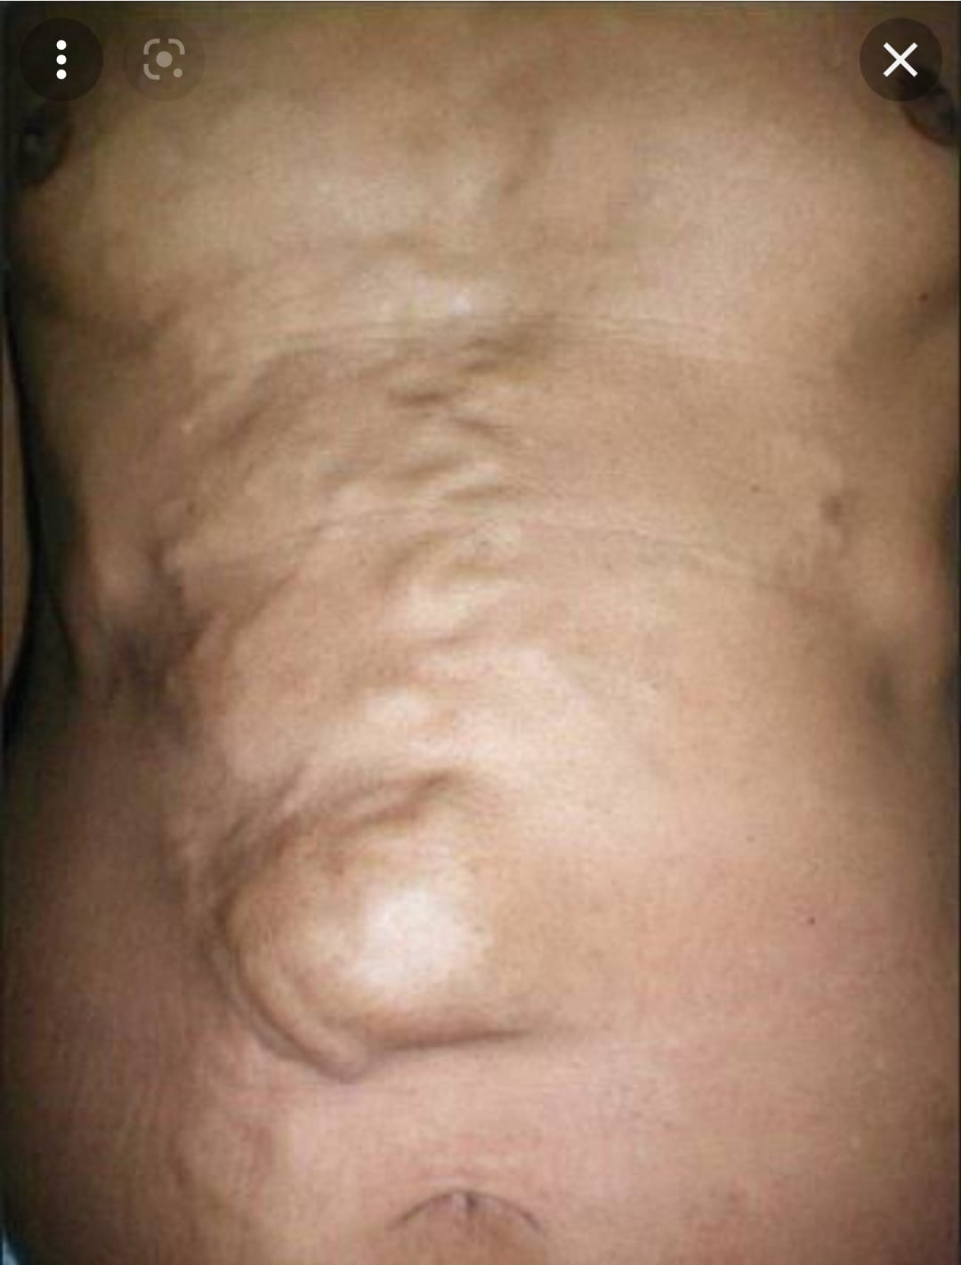

Slide 22
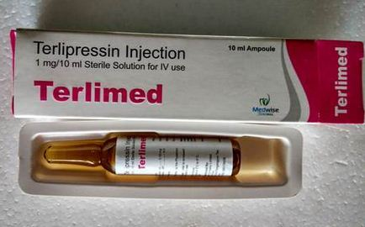
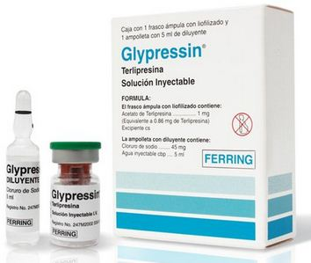
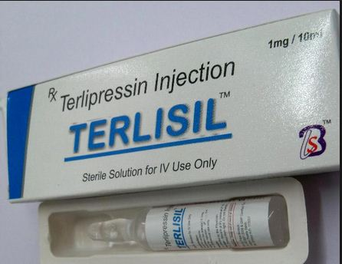

Slide 23


